Slide 1
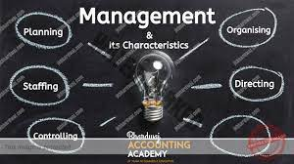
Dr. Satarupa Roychowdhury
SOMS, IIESTS

Slide 2
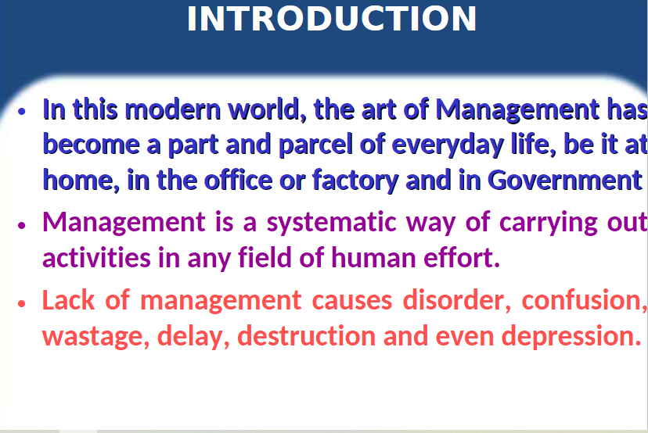

Slide 3
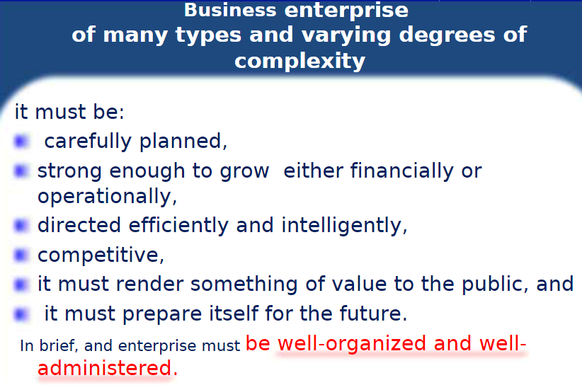

Slide 4
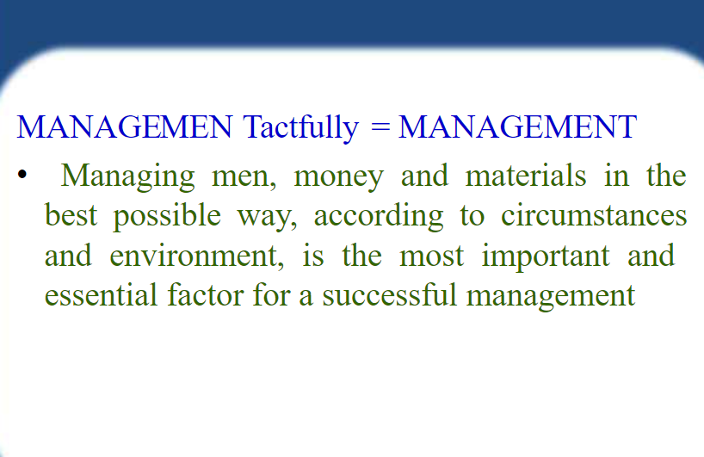

Slide 5
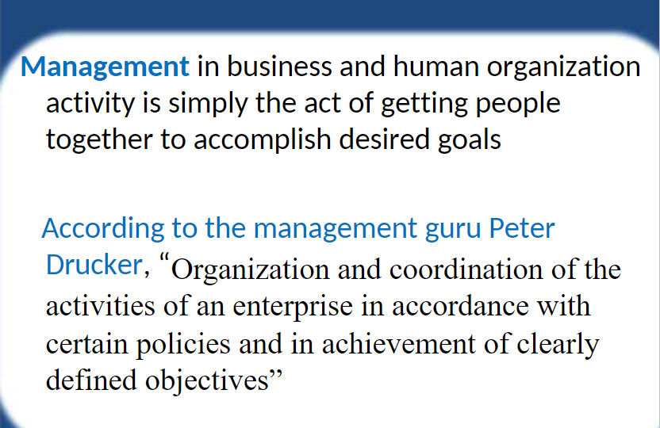

Slide 6
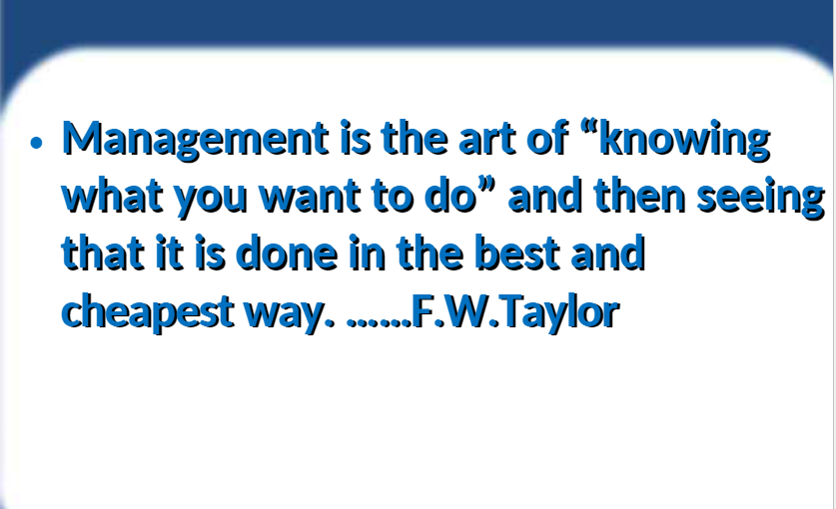

Slide 7
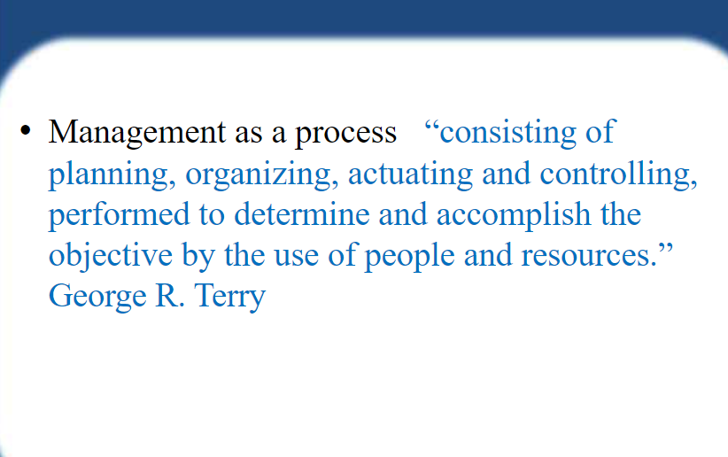

Slide 8
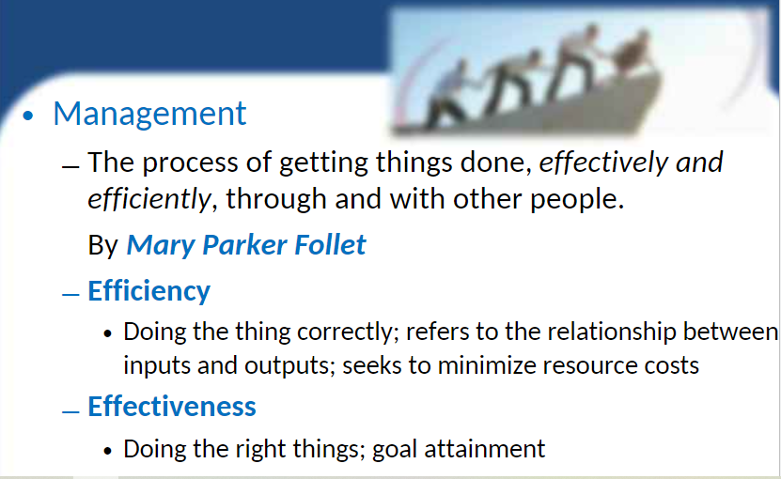

Slide 9
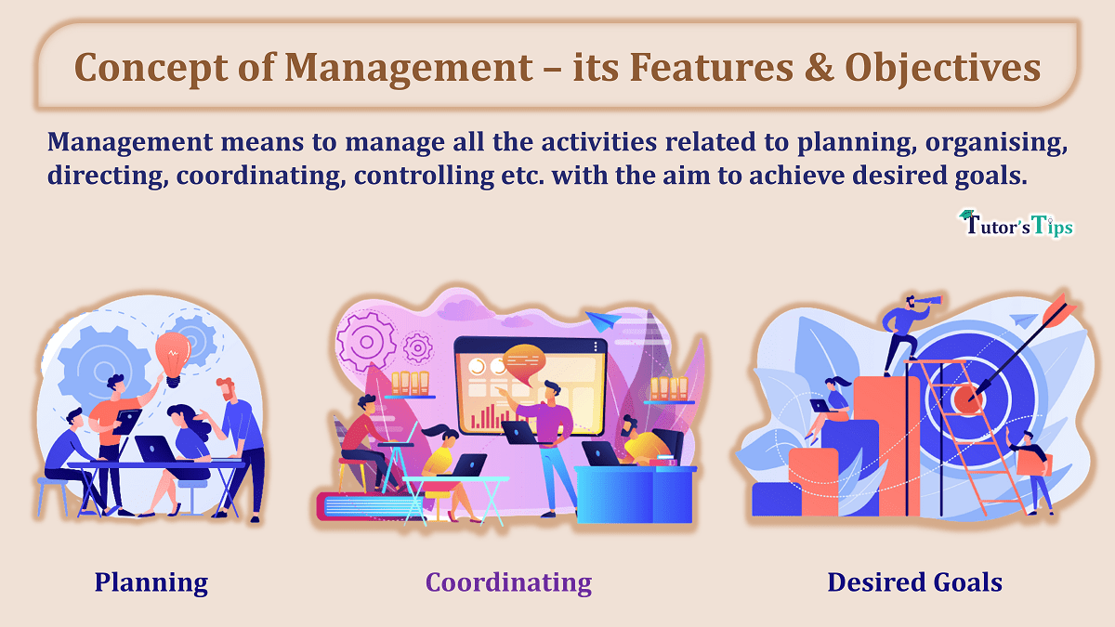

Slide 10
CONCEPT OF MANAGEMENT
Management is a very popular term and has been used extensively for all types of activities and mainly for taking charge of different activities in any enterprise.
Management, has therefore, been defined as a process of getting things done with the aim of achieving goals effectively and efficiently.

Slide 11
FEATURES/ CHARACHTERISTICS
1. Management is a goal-oriented process:
An organisation has a set of basic goals which are the basic reason for its existence. These should be simple and clearly stated. Different organisations have different goals. For example, the goal of a retail store may be to increase sales, but the goal of The Spastics Society of India is to impart education to children with special needs. Management unites the efforts of different individuals in the organisation towards achieving these goals.
2. Management is all pervasive:
The activities involved in managing an enterprise are common to all organisations whether economic, social or political. A petrol pump needs to be managed as much as a hospital or a school. What managers do in India, the USA, Germany or Japan is the same. How they do it may be quite different. This difference is due to the differences in culture, tradition and history.

Slide 12
3. Management is multidimensional:
Management is a complex activity that has three main dimensions. These are:
Management of work: All organisations exist for the performance of some work. In a factory, a product is manufactured, in a garment store a customer’s need is satisfied and in a hospital a patient is treated. Management translates this work in terms of goals to be achieved and assigns the means to achieve it. This is done in terms of problems to be solved, decisions to be made, plans to be established, budgets to be prepared, responsibilities to be assigned and authority to be delegated.
Management of people: Human resources or people are an organisation’s greatest asset. Managing people has two dimensions(i) it implies dealing with employees as individuals with diverse needs and behavior; (ii) it also means dealing with individuals as a group of people. The task of management is to make people work towards achieving the organisation’s goals, by making their strengths effective and their weaknesses irrelevant.

Slide 13
(c) Management of operations: No matter what the organisation, it has some basic product or service to provide in order to survive. This requires a production process which entails the flow of input material and the technology for transforming this input into the desired output for consumption. This is interlinked with both the management of work and the management of people.
4. Management is a continuous process:
The process of management is a series of continuous, composite, but separate functions (planning, organising, directing, staffing and controlling). These functions are simultaneously performed by all managers all the time.
5. Management is a group activity:
An organisation is a collection of diverse individuals with different needs. Every member of the group has a different purpose for joining the organisation but as members of the organisation they work towards fulfilling the common organisational goal. This requires team work and coordination of individual effort in a common direction.

Slide 14
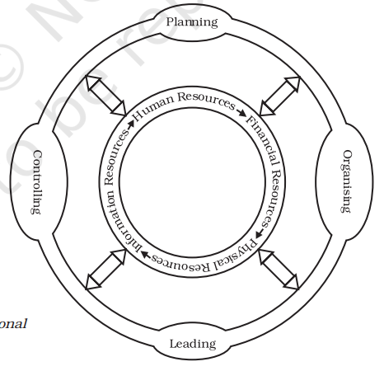

Slide 15
6. Management is a dynamic function:
Management is a dynamic function and has to adapt itself to the changing environment. An organisation interacts with its external environment which consists of various social, economic and political factors.
7. Management is an intangible force:
Management is an intangible force that cannot be seen but its presence can be felt in the way the organisation functions.

Slide 16
OBJECTIVES OF MANAGEMENT
Management seeks to achieve certain objectives which are the desired result of any activity. They must be derived from the basic purpose of the business. In any organisation there are different objectives and management has to achieve all objectives in an effective and efficient manner. Objectives can be classified into organisational objectives, social objectives and personal or individual objectives.
The main objective of any organisation should be to utilise human and material resources to the maximum possible advantage, i.e., to fulfill the economic objectives of a business. These are survival, profit and growth.

Slide 17
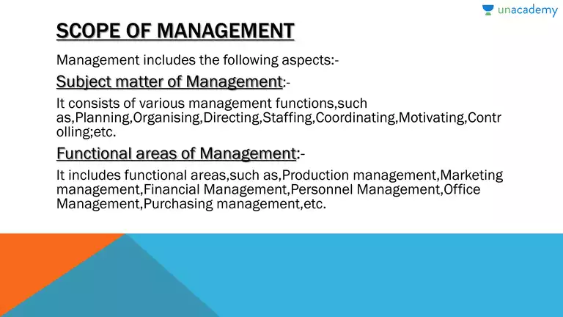
SCOPE OF MANAGEMENT

Slide 18
The scope of management is not only limited to the implementation or formulation of policies, but the use of physical and human resources also comes under management. Management scope is very wide as it includes policy-making, planning, organising, policy implementation, use of physical and human resources etc.
According to Taylor – “The basic principles of scientific management apply to all human activities, from the simplest individual tasks to the great corporations.”
According to Henry Fayol – “Management is a universal science which is equally applicable to all places of industry, politics, commerce, war religion, and public welfare.” etc.
Thus, management is a universal term and its scope is very wide, therefore no limit can be fixed for managerial activities because to bind them to one limit will have to narrow their scope.

Slide 19
(1) Functional Areas of Management:
A committee of the Ministry of Education of England (Committee on Education for Management) in its report has divided business management into 9 categories which are known as functional areas of management.
These are as follows:
(i) Production Management:
Under this branch of management, the quantity of production, management of material of production, designing, production-planning, work-analysis, quality control, what is to be produced and when to get it done, etc.
(ii) Financial Management:
Under this, the work of making financial estimates, financial planning, finding out various sources of finance and collecting finance and making the best use of finance possible, financial control, etc.
(iii) Personal Management:
This branch of management includes recruitment, selection, training, job evaluation, merit-marking, labour welfare, promotion, reduction, retirement, transfer, social security, prevention of accidents, improvement in working conditions, settlement of disputes, industrial Improvement of relations, remuneration, etc. includes works in its field.

Slide 20
(iv) Marketing Management:
Marketing management is the organizational discipline which focuses on the practical application of marketing orientation, techniques and methods inside enterprises and organizations and on the management of a firm's marketing resources and activities.
(v) Sales & Distribution Management:
It is also called marketing management. Under this, sales advertisement of goods, sales promotion, market research, establishment and operation of sales branches, selection of distribution-chains, sales-power-management, pricing of the commodity, internal market and export arrangements, etc.
(vi) Logistics Management:
Apart from this, packing of goods, setting up of Ware Housing and choosing different modes of transport like rail, road, air, water, etc. This branch of management is concerned with transporting goods and people from one place to another at a low cost and in less time.
(vii) Purchase Management:
Under this, asking for tender from the suppliers of goods, ordering goods, purchasing goods, maintenance of goods and material control, etc.
(viii) Installation or Maintenance Management:
Under this, the maintenance and proper care of buildings, plants, machines, and other equipment come.
(ix) Office Management:
Under this, correspondence, receiving and dispatching information, maintaining the contact chain within the organization, taking care of forms and documents, keeping records, etc.

Slide 21
Management as an Art: What is art?
Art is the skillful and personal application of existing knowledge to achieve desired results. It can be acquired through study, observation and experience. Since art is concerned with personal application of knowledge some kind of ingenuity and creativity is required to practice the basic principles learnt. The basic features of an art are as follows:
(i) Existence of theoretical knowledge: Art presupposes the existence of certain theoretical knowledge. Experts in their respective areas have derived certain basic principles which are applicable to a particular form of art. For example, literature on dancing, public speaking, acting or music is widely recognised.
(ii) Personalised application: The use of this basic knowledge varies from individual to individual. Art, therefore, is a very personalised concept. For example, two dancers, two speakers, two actors, or two writers will always differ in demonstrating their art.

Slide 22
(iii) Based on practice and creativity: All art is practical. Art involves the creative practice of existing theoretical knowledge. We know that all music is based on seven basic notes. However, what makes the composition of a musician unique or different is his use of these notes in a creative manner that is entirely his own interpretation.
Management can be said to be an art since it satisfies the following criteria:
A successful manager practices the art of management in the day-to-day job of managing an enterprise based on study, observation and experience. There is a lot of literature available in various areas of management like marketing, finance and human resources which the manager has to specialise in. There is existence of theoretical knowledge.

Slide 23
There are various theories of management, as propounded by many management thinkers, which prescribe certain universal principles. A manager applies these scientific methods and body of knowledge to a given situation, an issue or a problem, in his own unique manner. A good manager works through a combination of practice, creativity, imagination, initiative and innovation. A manager achieves perfection after long practice. Students of management also apply these principles differently depending on how creative they are.
A manager applies this acquired knowledge in a personalised and skillful manner in the light of the realities of a given situation. He is involved in the activities of the organisation, studies critical situations and formulates his own theories for use in a given situation. This gives rise to different styles of management.

Slide 24
Management as a Science:
Science is a systematised body of knowledge that explains certain general truths or the operation of general laws. The basic features of science are as follows:
Systematised body of knowledge: Science is a systematic body of knowledge. Its principles are based on a cause and effect relationship. For example, the phenomenon of an apple falling from a tree towards the ground is explained by the law of gravity.
Principles based on experimentation: Scientific principles are first developed through observation and then tested through repeated experimentation under controlled conditions.
Universal validity: Scientific principles have universal validity and application.

Slide 25
Based on the above features, we can say that management has some characteristics of science.
Management has a systematised body of knowledge. It has its own theory and principles that have developed over a period of time, but it also draws on other disciplines such as Economics, Sociology, Psychology and Mathematics. Like all other organised activity, management has its own vocabulary of terms and concepts.
The principles of management have evolved over a period of time based on repeated experimentation and observation in different types of organisations. However, since management deals with human beings and human behaviour, the outcomes of these experiments are not capable of being accurately predicted or replicated. Therefore, management can be called an inexact science.

Slide 26
MANAGEMENT AS A PROFESSION
A profession has the following characteristics:
(i) Well-defined body of knowledge: All professions are based on a well-defined body of knowledge that can be acquired through instruction.
(ii) Restricted entry: The entry to a profession is restricted through an examination or through acquiring an educational degree. For example, to become a chartered accountant in India a candidate has to clear a specified examination conducted by the Institute of Chartered Accountants of India.
(iii) Professional association: All professions are affiliated to a professional association which regulates entry, grants certificate of practice and formulates and enforces a code of conduct. To be able to practice in India lawyers have to become members of the Bar Council which regulates and controls their activities.

Slide 27
(iv) Ethical code of conduct: All professions are bound by a code of conduct which guides the behaviour of its members. All doctors, for example, take the oath of ethical practice at the time they enter the profession.
(v) Service motive: The basic motive of a profession is to serve their client’s interests by rendering dedicated and committed service. The task of a lawyer is to ensure that his client gets justice.

Slide 28
Management does not meet the exact criteria of a profession. However, it does have some of the features of a profession:
All over the world there is marked growth in management as a discipline. It is based on a systematic body of knowledge comprising well-defined principles based on a variety of business situations. This knowledge can be acquired at different colleges and professional institutes and through a number of books and journals.
There is no restriction on anyone being designated or appointed as manager in any business enterprise. Anyone can be called a manager irrespective of the educational qualifications possessed. Unlike professions such as medicine or law which require a practicing doctor or lawyer to possess valid degrees, nowhere in the world is it mandatory for a manager to possess any such specific degree. But professional knowledge and training is considered to be a desirable qualification, since there is greater demand for those who possess degrees or diplomas from reputed institutions. Therefore, as such the second criterion has not been strictly met.

Slide 29
There are several associations of practicing managers in India, like the AIMA (All India Management Association) that has laid down a code of conduct to regulate the activities of their members. There is, however, no compulsion for managers to be members of such an association nor does it have any statutory backing.
The basic purpose of management is to help the organisation achieve its stated goal. This may be profit maximisation for a business enterprise and service for a hospital. However, profit maximisation as the objective of management does not hold true and is fast changing. Therefore, if an organisation has a good management team that is efficient and effective it automatically serves society by providing good quality products at reasonable prices.

Slide 30
Importance of Management
Having understood that management is a universal activity that is integral to any organisation we now examine some of the reasons that have made management so important:
(i) Management helps in achieving group goals: Management is required not for itself butfor achieving the goals of the organisation. The task of a manager is to give a common direction to the individual effort in achieving the overall goal of the organisation.
(ii) Management increases efficiency: The aim of a manager is to reduce costs and increase productivity through better planning, organising, directing, staffing and controlling the activities of the organisation.
(iii) Management creates a dynamic organisation: All organisations have to function in an environment which is constantly changing. It is generally seen that individuals in an organisation resist change as it often means moving from a familiar, secure environment into a newer and more challenging one. Management helps people adapt to these changes so that the organisation is able to maintain its competitive edge.

Slide 31
(iv) Management helps in achieving personal objectives: A manager motivates and leads his team in such a manner that individual members are able to achieve personal goals while contributing to the overall organisational objective. Through motivation and leadership the management helps individuals to develop team spirit, cooperation and commitment to group success.
(v) Management helps in the development of society: An organisation has multiple objectives to serve the purpose of the different groups that constitute it. In the process of fulfilling all these, management helps in the development of the organisation and through that it helps in the development of society. It helps to provide good quality products and services, creates employment opportunities, adopts new techno-logy for the greater good of the people and leads the path towards growth and development.

Slide 32
Levels of Management
Management is a universal term used for certain functions performed by individuals in an enterprise who are bound together in a hierarchy of relationships.
Every individual in the hierarchy is responsible for successful completion of a particular task. To be able to fulfill that responsibility he is assigned a certain amount of authority or the right to take a decision.
This authority-responsibility relationship binds individuals as superiors and subordinates and gives rise to different levels in an organisation. Generally speaking there are three levels in the hierarchy of an organisation.

Slide 33
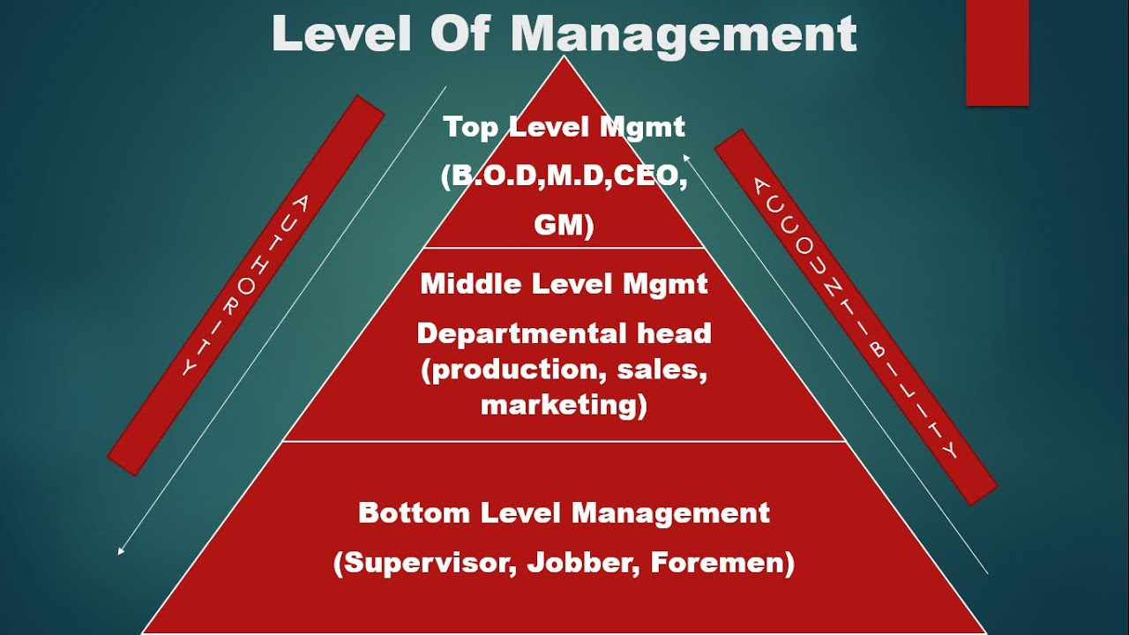

Slide 34
1. Top Management
They consist of the senior-most executives of the organisation by whatever name they are called. They are usually referred to as the chairman, the chief executive officer, chief operating officer, president and vice-president.
Top management is a team consisting of managers from different functional levels, heading finance, marketing etc. For example chief finance officer, vice president (marketing). Their basic task is to integrate diverse elements and coordinate the activities of different departments according to the overall objectives of the organisation.
These top level managers are responsible for the welfare and survival of the organisation. They analyse the business environment and its implications for the survival of the firm. They formulate overall organisational goals and strategies for their achievement. They are responsible for all the activities of the business and for its impact on society. The job of the top manager is complex and stressful, demanding long hours and commitment to the organisation.

Slide 35
2. Middle Management
Middle Management is the link between top and lower level managers. They are subordinate to top managers and superior to the first line managers.
They are usually known as division heads, for example production manager.
Middle management is responsible for implementing and controlling plans and strategies developed by top management. At the same time they are responsible for all the activities of first line managers.
Their main task is to carry out the plans formulated by the top managers. For this they need to:
(i) interpret the policies framed by top management,
(ii) ensure that their department has the necessary personnel,
(iii) assign necessary duties and responsibilities to them,
(iv) motivate them to achieve desired objectives, and
(v) cooperate with other departments for smooth functioning of theorganisation. At the same time they are responsible for all the activities of first line managers.

Slide 36
3. Supervisory or Operational Management
Supervisory or Operational Management: Foremen and supervisors comprise the lower level in the hierarchy of the organisation. Supervisors directly oversee the efforts of the workforce. Their authority and responsibility is limited according to the plans drawn by the top management.
Supervisory management plays a very important role in the organisation since they interact with the actual work force and pass on instructions of the middle management to the workers. Through their efforts quality of output is maintained, wastage of materials is minimised and safety standards are maintained.
The quality of workmanship and the quantity of output depends on the hard work, discipline and loyalty of the workers.

Slide 37
Functions of Management
Management is described as the process of planning, organising, directing and controlling the efforts of organisational members and of using organisational resources to achieve specific goals.
Planning is the function of determining in advance what is to be done and who is to do it. This implies setting goals in advance and developing a way of achieving them efficiently and effectively. Planning cannot prevent problems, but it can predict them and prepare contingency plans to deal with them if and when they occur.
Organizing is the management function of assigning duties, grouping tasks, establishing authority and allocating resources required to carry out a specific plan. Once a specific plan has been established for the accomplishment of an organisational goal, the organising function examines the activities and resources required to implement the plan. It determines what activities and resources are required. It decides who will do a particular task, where it will be done, and when it will be done. Organising involves the grouping of the required tasks into manageable departments or work units and the establishment of authority and reporting relationships within the organisational hierarchy. Proper organisational techniques help in the accomplishment of work and promote both the efficiency of operations and the effectiveness of results. Different kinds of business require different structures according to the nature of work.

Slide 38
Staffing simply stated, is finding the right people for the right job. A very important aspect of management is to make sure that the right people with the right qualifications are available at the right places and times to accomplish the goals of the organisation. This is also known as the human resource function and it involves activities such as recruitment, selection, placement and training of personnel. Infosys Technologies which develops software needs systems analysts and programmers.
Directing involves leading, influencing and motivating employees to perform the tasks assigned to them. This requires establishing an atmosphere that encourages employees to do their best. Motivation and leadership are two key components of direction. Directing also involves communicating effectively as well as supervising employees at work. Motivating workers means simply creating an environment that makes them want to work. Leadership is influencing others to do what the leader wants them to do. A good manager directs through praise and criticism in such a way that it brings out the best in the employee.

Slide 39
Controlling is the management function of monitoring organisational performance towards the attainment of organisational goals. The task of controlling involves establishing standards of performance, measuring current performance, comparing this with established standards and taking corrective action where any deviation is found. Here management must determine what activities and outputs are critical to success, how and where they can be measured and who should have the authority to take corrective action.

